Slide 1

HIVE SENTINEL:
THE HACKER’S CONFINE
Final Year Project Presentation
Presented By:
Mariyam
Qaseem Ul Hassan
Industrial Supervisor:
Dr. Nabeel Ahmed Awan
Academic Supervisor:
Dr. Abdul Waheed Khan

Slide 2

Background
Intoduction
Overview
Project Modules
Mockups
Current Working

Slide 3

Background
Firewalls:
digital barriers to control incoming and outgoing network traffic
Anti-virus:
detect and eliminate malicious software

Slide 4

Introduction to Honeypots
1. Identifying Vulnerabilities in system
2. Studying Techniques, methods of attacker
3. Identifying zero day attacks

Slide 5
Introduction to Honeypots
Deception 1.0:
Limited Scalability
Static Environments
Easily Idnetifiable
Manual Management
Deception 2.0:
Scalable and Distributed Architectures
Dynamic and Adaptive Environments
Enhanced Realism
Integration with Threat Intelligence
Automation

Slide 6
Create Machines
2. Logs Generation and storage
Project Modules
3. MITRE ATT&CK Mapping
4. Identify Threats
5. Health Monitoring

Slide 7
Create Machines
This module focuses on automating the process of creating machines through Terraform and deploying services on the created machines through Ansible from dashboard.

Slide 8
Logs generation and storage
This module focuses on generating logs on honeypots in response to event detected through Sysmon and Auditd.
Exporting logs on centralized database Elastic search.
Display logs on dashboard.

Slide 9
MITRE ATT&CK MAPPING
This module focuses on mapping generated logs with MITRE ATT&CK Techniques.
Display MITRE ATT&CK mapping on dashboard.

Slide 10
IDENTIFY THREATS
This module focuses on identifying threat from generated logs with the help of signature-based detection and displaying on dashboard.
Signature-based detection include comparing Sysmon logs with pre-defined attack list of python and identifying threats.

Slide 11
Health Monitoring
This module focuses on fetching health monitoring parameters from honeypots
Display health of honeypots on dashboard
Honeypot Re-spawning based on machine health

Slide 12
MOCKUPS

Slide 13
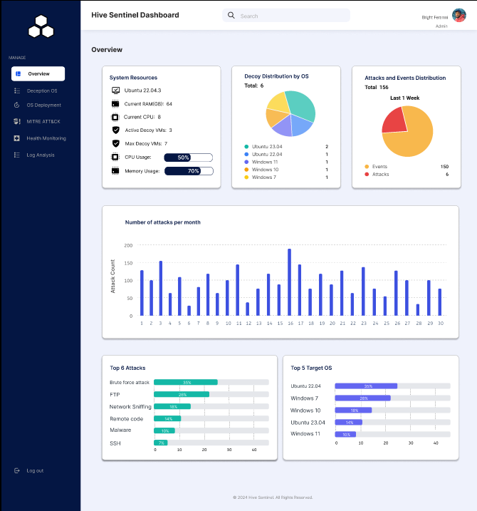

Slide 14
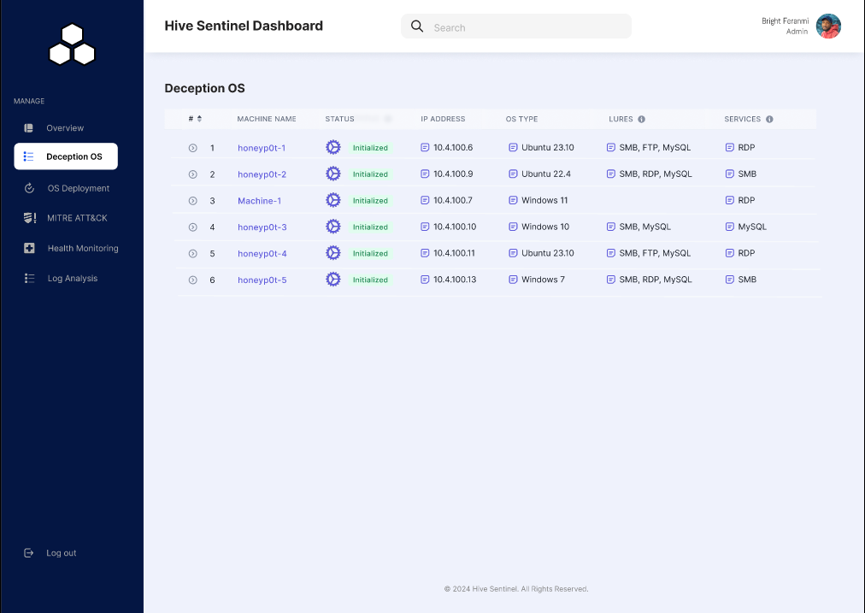

Slide 15
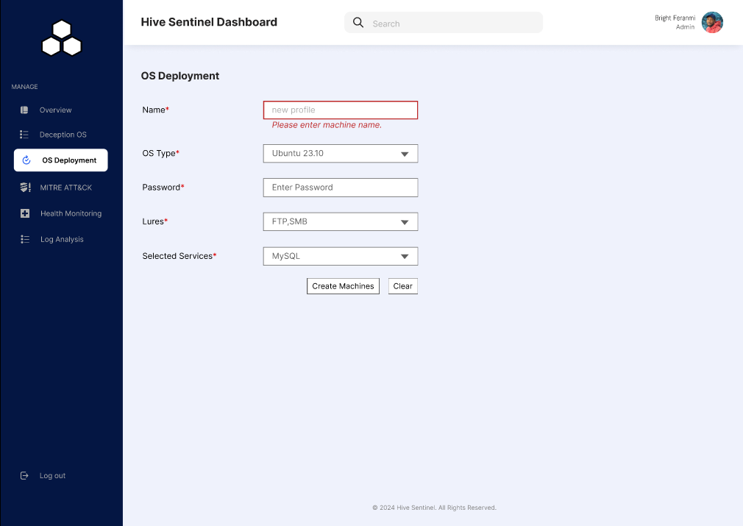

Slide 16
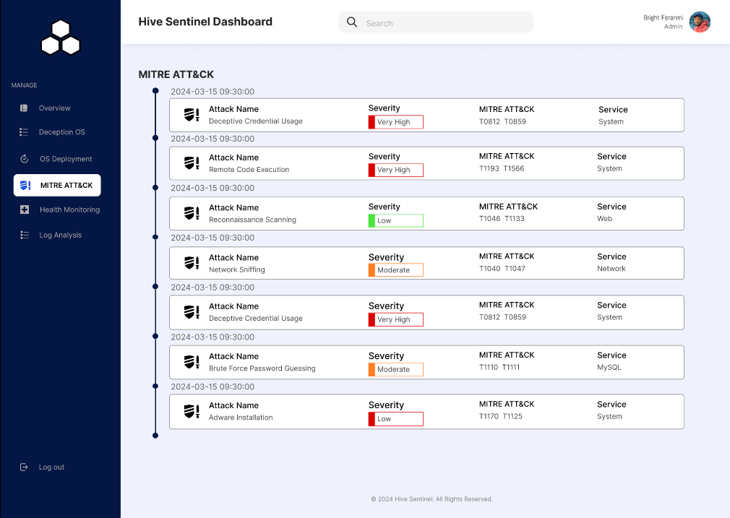

Slide 17
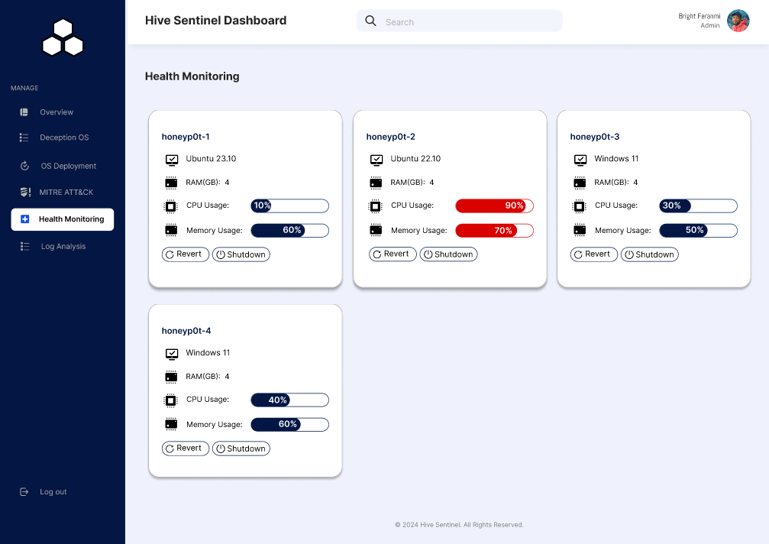

Slide 18
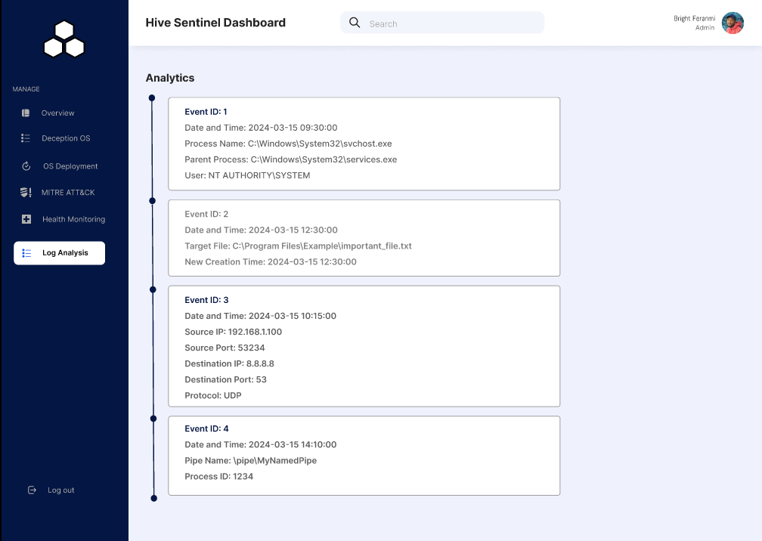

Slide 19
CURRENT WORKING

Slide 20
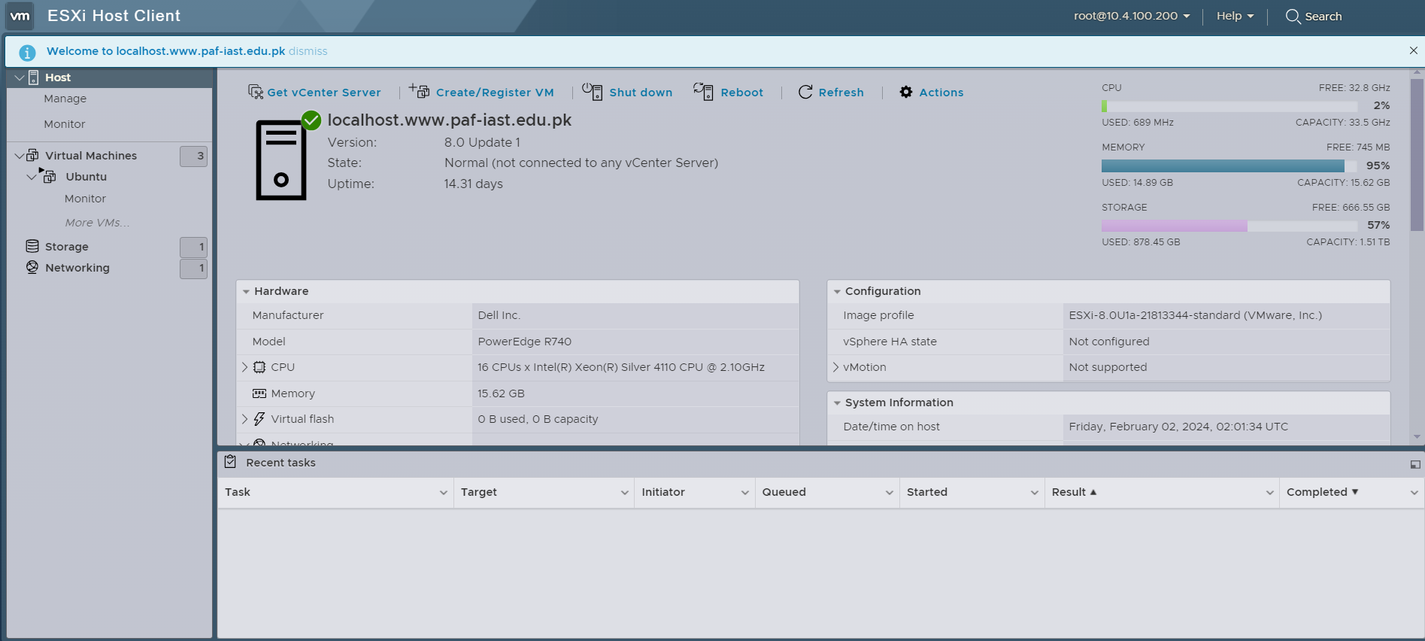

Slide 21
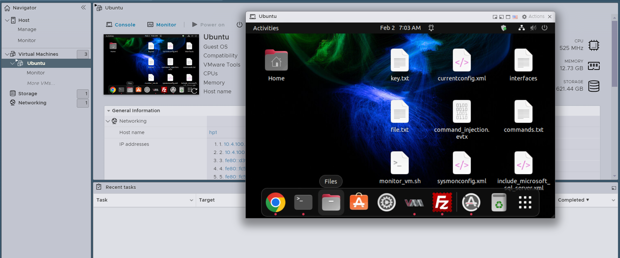

Slide 22
Screenshots
of Attacks-1

Slide 23
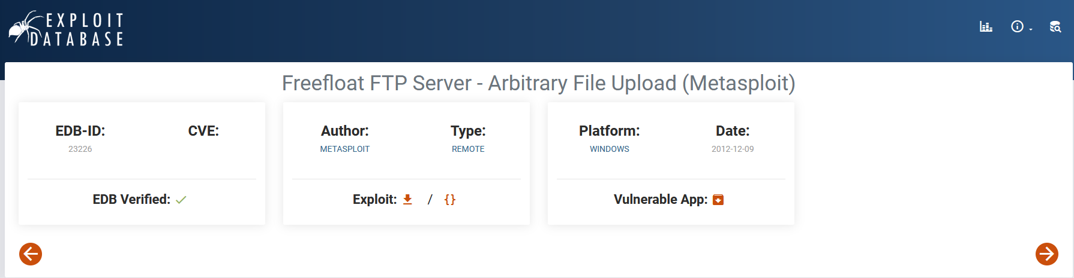

Slide 24
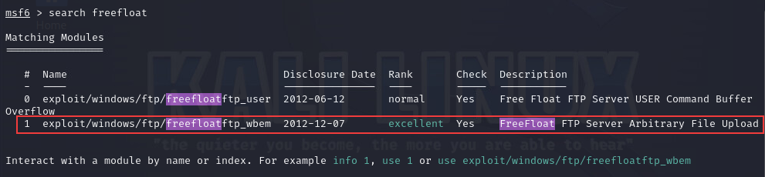

Slide 25
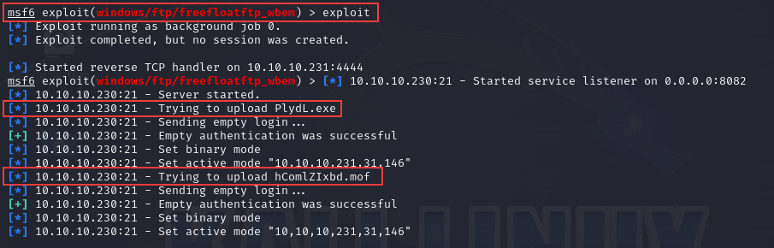

Slide 26
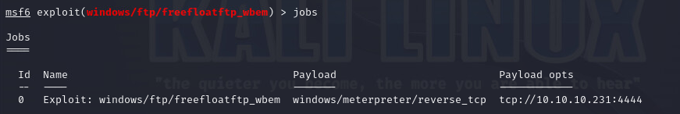

Slide 27
Screenshot
of Attack-2

Slide 28
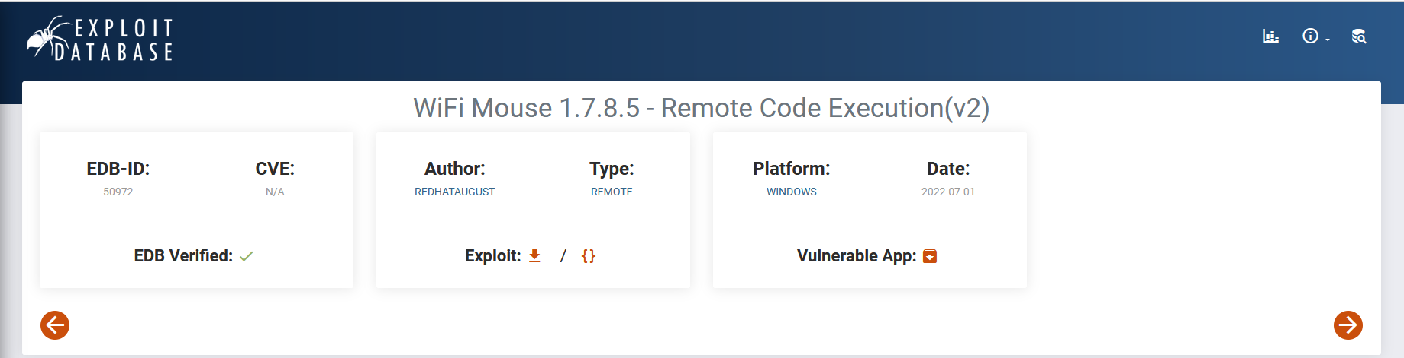

Slide 29
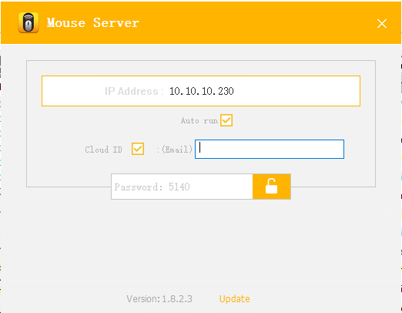

Slide 30
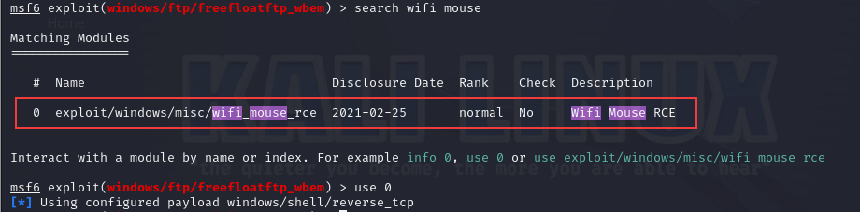

Slide 31
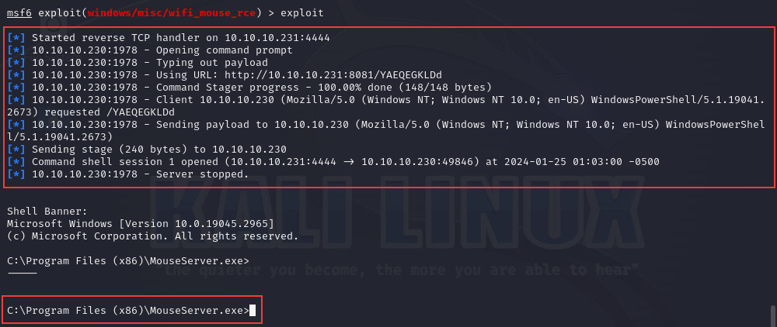

Slide 32
Screenshots of
Attack with logging and Mitre mapping

Slide 33
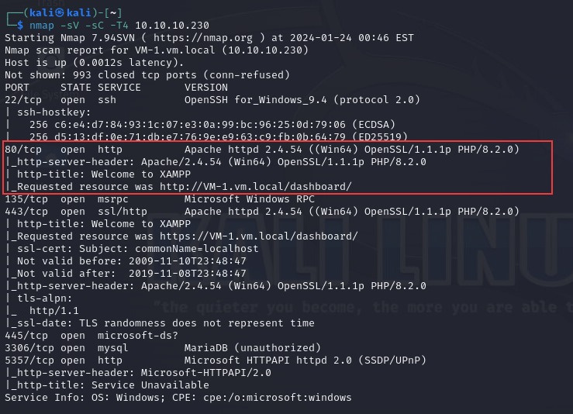

Slide 34
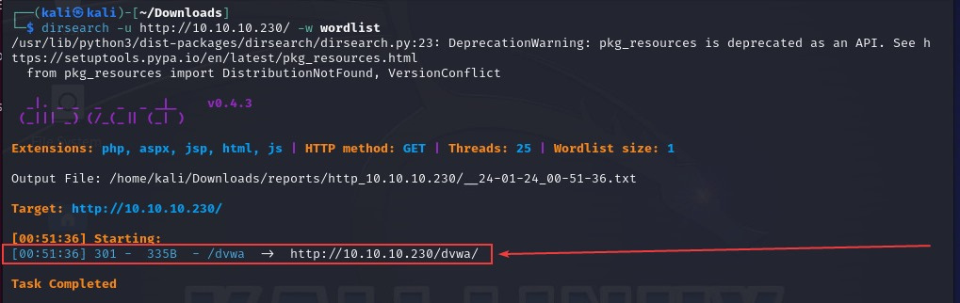

Slide 35
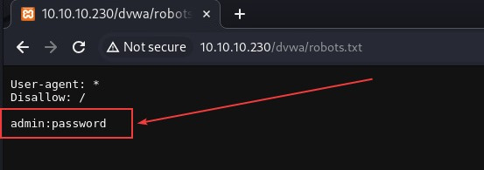

Slide 36
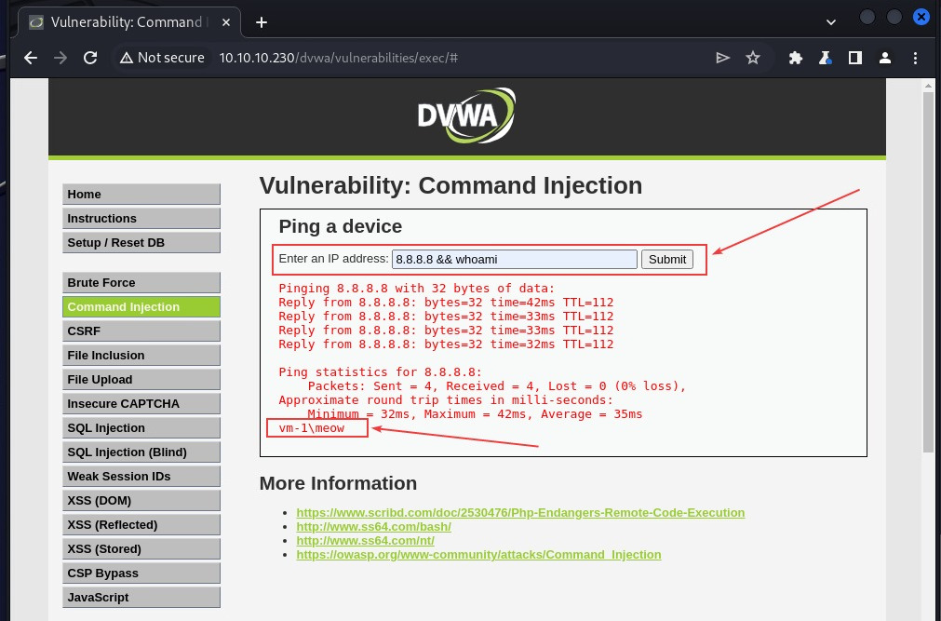

Slide 37
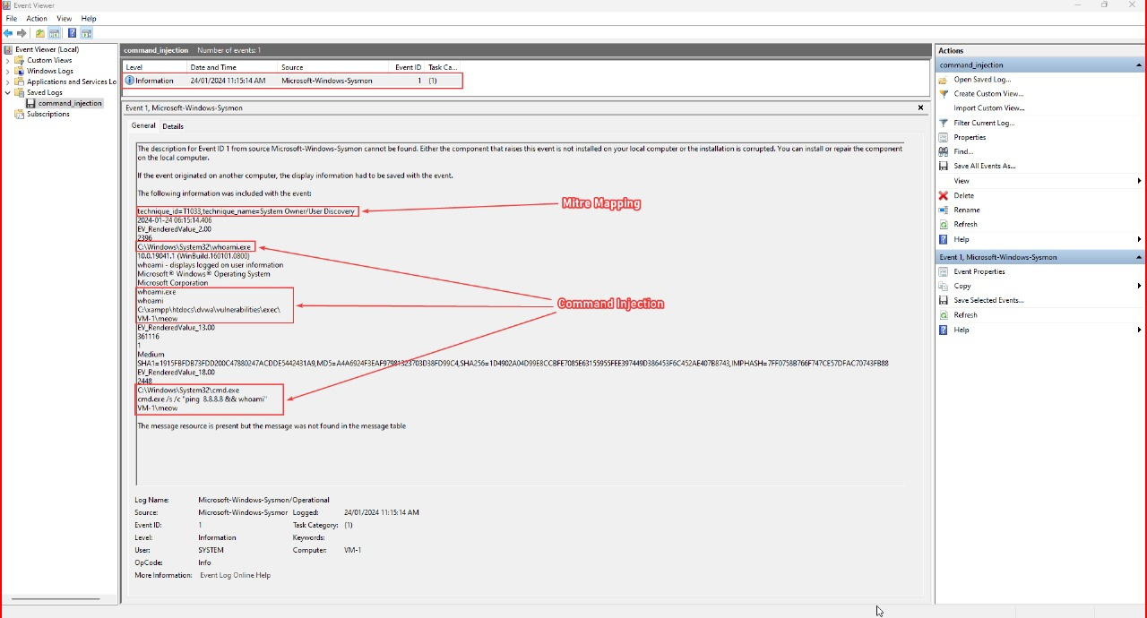

Slide 38
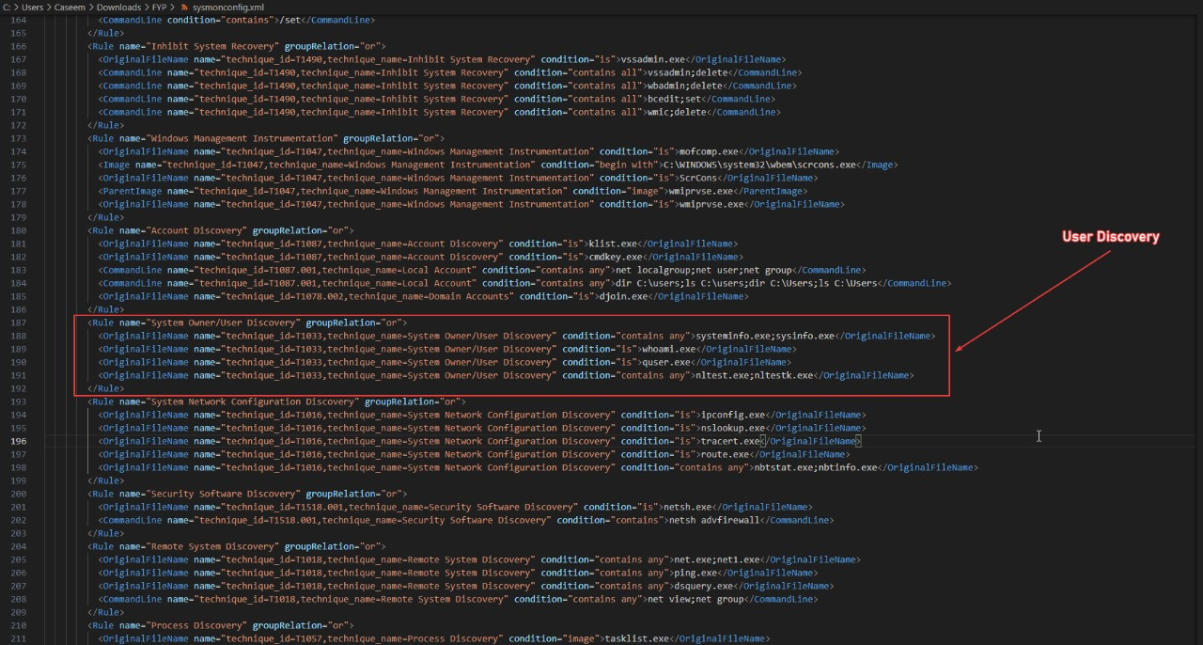

Slide 39

Questions & Comments

